Slide 1
mywealthanalyst landing page concept
03/06/2019

Slide 2
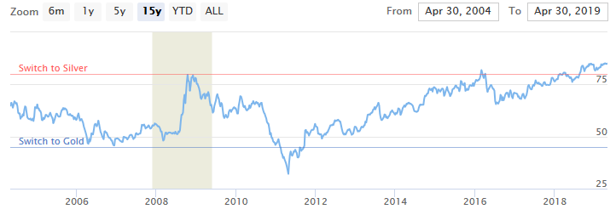



The information you need to preserve your wealth for generations
Clarity – directly compare performance of assets
Notifications – don’t miss critical cycle changes
Free – donate & support us support you
Get Started

Slide 3

Bringing clarity to investment decisions
Remove the noise and compare assets directly for relative performance, and identify long term cycles & trends.

Slide 4


Do not miss critical asset cycle changes with email notifications
!
Remain informed as key turning points are reached with email notifications, allowing you to modify your asset investment strategy on the go.

Slide 5




One click access to purchase quality investment assets
We partner with specialist suppliers of quality assets for you to seamlessly and efficiently manage your investments.
BUY NOW

Slide 6

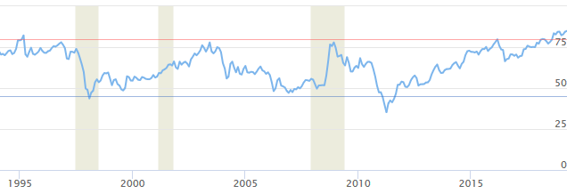

How John uses mywealthanalyst to increase his wealth
In 2008 John converts his 1.65 oz. of Gold into 129 oz. of Silver
In 2007 John converts his 78 oz. of Silver into 1.65 oz. of Gold
In 1998 John & Jane both invest in 1 oz. of Gold bullion
In 2011 John converts his 129 oz. of Silver into 2.9 oz. of Gold
In 13 years John has doubled his wealth increasing from 1 oz. to 2.9 oz. of Gold
In 2003 John converts his 1 oz. Gold bullion into 78 ounces of Silver
GOLD:SILVER RATIO
Switch to Silver
78oz
129oz
Switch to Gold
1.0oz
1.65oz
2.9oz
Jane’s wealth doesn’t change
Jane holds her investment

Slide 7
How John uses mywealthanalyst to increase his wealth
In 2008 John converts his 1.65 oz. of Gold into 129 oz. of Silver
In 2007 John converts his 78 oz. of Silver into 1.65 oz. of Gold
In 1998 John & Jane both invest in 1 oz. of Gold bullion
In 2011 John converts his 129 oz. of Silver into 2.9 oz. of Gold
In 13 years John has doubled his wealth increasing from 1 oz. to 2.9 oz. of Gold
In 2003 John converts his 1 oz. Gold bullion into 78 ounces of Silver
GOLD:SILVER RATIO
Switch to Silver
78oz
129oz
1.0oz
1.65oz
2.9oz
Switch to Gold
Jane’s wealth doesn’t change
Jane holds her investment

Slide 8
Frequently Asked Questions
How much does it cost?
There is no cost, access is free, however feel free to donate and support us!
How frequently is the live data refreshed?
Live data prices are refreshed every 5 minutes with property values refreshed quarterly
How frequently are the graphs refreshed?
Graphs data is accumulated twice daily and quarterly for property values

